Slide 1

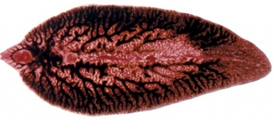

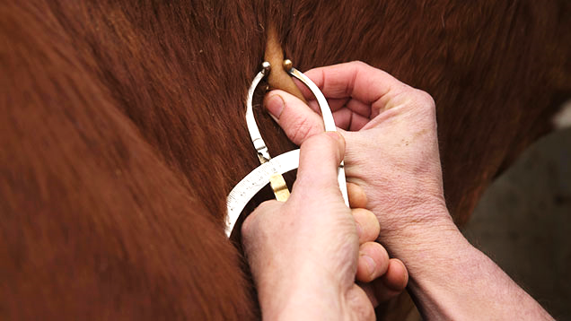

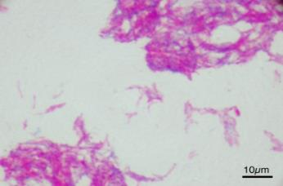
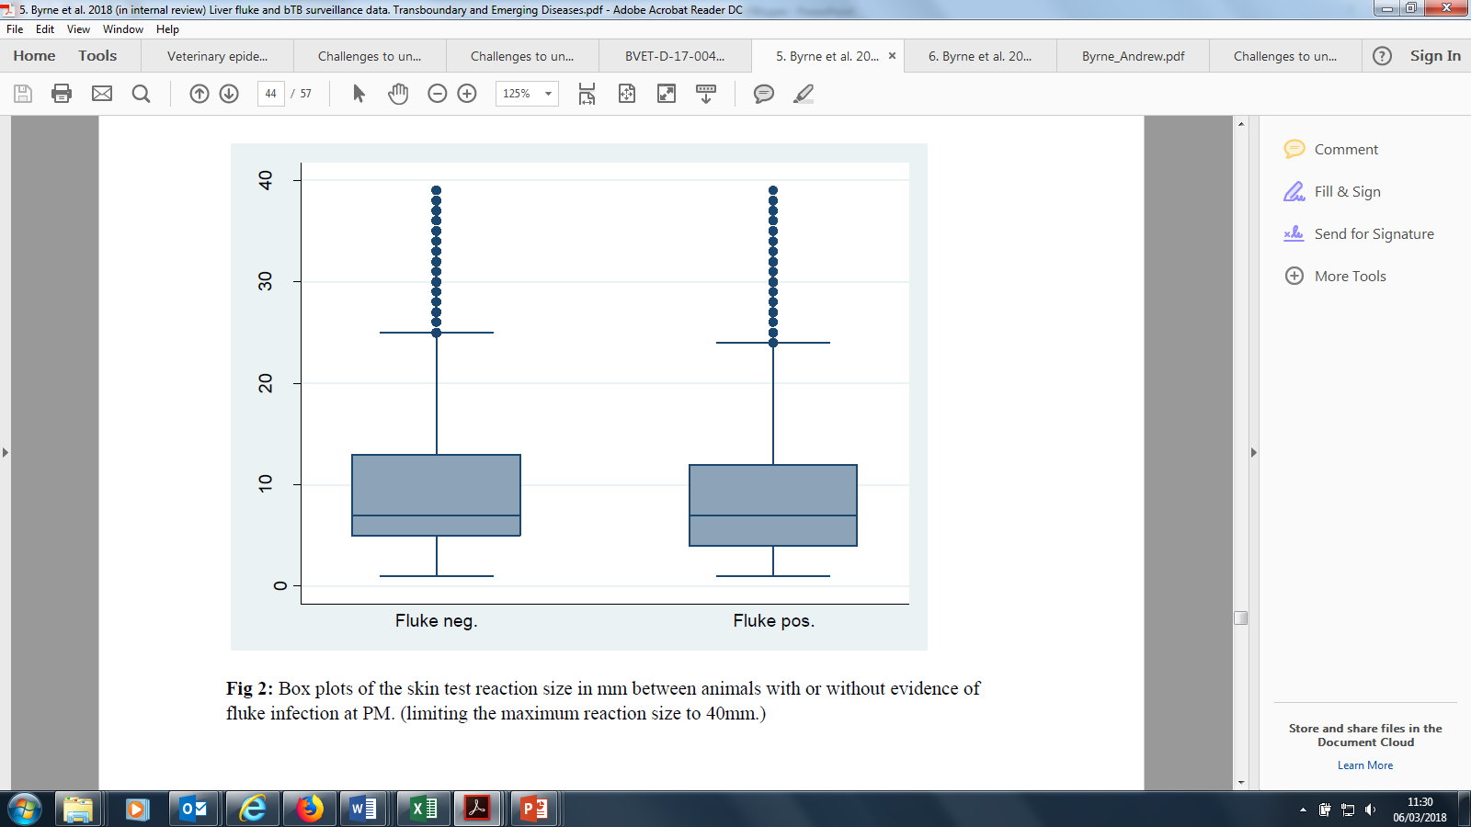
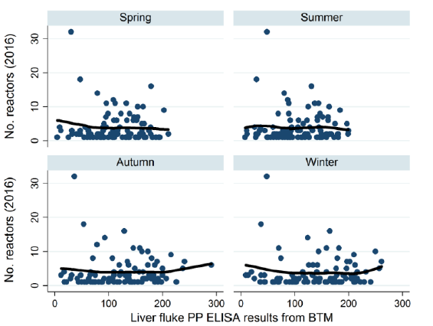

Co-infection: Is there a nexus between liver fluke (Fasciola hepatica) and bovine tuberculosis (Mycobacterium bovis)?
Andrew W. Byrne, Jordon Graham, Maria Guelbenzu, Angela Lahuerta-Marin, Stewart McBride, James McConville, Jim McNair, Georgina Milne, Robin Skuce, Stanley McDowell
Veterinary Sciences Division, Agri-Food and Biosciences Institute, Stormont, Belfast BT4 3SD, Northern Ireland. ecologicalepidemiology@gmail.com; andrew.byrne@afbini.gov.uk
Introduction
Co-infections generally have potential to impact pathogenesis, epidemiology and diagnosis
Liver fluke (F. hepatica) is reported to impact bovine tuberculosis (bTB; caused by M. bovis) pathogenesis and diagnosis (Claridge et al 2012)
Some co-infection results have been equivocal or of low effect size (Howell 2017).
Co-infection impact on bTB skin-test and herd-risk
Is there an association in cattle herds in Northern Ireland?
We used a retrospective animal level design (study 1, 2) and a herd-level prospective (study 3) design to find out!
F. hepatica
Tuberculin skin tests
Herd bTB risk
M. bovis
Animal Level risk
Herd Level risk
Study 1: H⁰ no association between fluke+TB metrics
Design = animal-level, retrospective, case-control
Data = 138,566 animal records from 1 abattoir in Northern Ireland (2011-2013); liver fluke (LF) status = presence of LF or LF organ damage
Model: Multivariable binary logit random effect (RE = herd clustering)
Controlled for: age, sex, region, weather/climate, enterprise type (dairy v. beef), herd size, year
Binary outcomes (+/-):
  Skin-test reactor (standard and severe interpretation)
  Post-mortem (PM) lesion presence
  PM confirmed infection (histolopathology/culture)
  lesion at routine slaughter (LRS; SCITT negative, lesion positive or confirmed (cLRS))
Study 2:
Animal-level, cohort study
Data: n=21,944 records
Model: RE multivariable Gaussian regression
Outcome: bovine-avian tuberculin reaction size (mm)
Result: No association between reaction size and fluke infection (p=0.349)
Skin test reaction size (mm)
Fig. 1: Relationship between PM fluke status and skin test tuberculin reaction size
Study 3
Herd-level, prospective, cohort study
Data: n=1,492 dairy herds
Bulk milk sampled four times (seasons); ELISA antibody tested (IDEXX)
Models: RE multivariable binary logit random effect & RE Poisson model
Outcome: Herd TB status (SICCT, confirmed), breakdown size (reactor counts)
Outcome | 1^{y} Predictor | P | Reject null
Skin-test reactor (std) | PM LF status | 0.399 | ✗
Skin-test reactor (severe) | PM LF status | 0.762 | ✗
Lesion | PM LF status | 0.997 | ✗
Confirmed | PM LF status | 0.976 | ✗
LRS | PM LF status | 0.042 | ✓
cLRS | PM LF status | 0.025 | ✓
Confirmed+S/P%: p=0.857
Confirmed+LF: p= 0.778
Reactor counts: S/P% value (p= 0.849), herd infection status (p= 0.874) and liver fluke infection class level (p= 0.997)
Fig. 2: Relationship between the number of TB reactors within a herd 2016 and liver fluke ELISA bulk tank milk (BTM) results
SLKDJFL
Conclusions
Limited population-level evidence that this co-infection affects ante mortem bTB diagnostics
No significant association with dairy herd-level risk based on F. hepatica bulk milk ELISA testing
This co-infection might affect pathogenesis, which in turn affects surveillance
Refs: Claridge, J. et al. 2012 Nature Comms, 3, 853; Howell, A.K. PhD diss., University of Liverpool, 2017.

