Slide 1
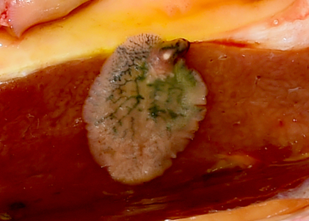


The potential effect of disease misclassification in abattoir surveys on estimating impact of Fasciola hepatica on time to slaughter
Rebecca Carroll^{1,2}, Andrew Forbes³, David A. Graham², Locksley L. McV. Messam¹
¹School of Veterinary Medicine, University College Dublin, Dublin, Ireland, ²Animal Health Ireland, Carrick-on-Shannon, Co. Leitrim, Ireland, ³School of Veterinary Medicine, Glasgow University, Glasgow, United Kingdom
Introduction
Post-mortem diagnosis of fasciolosis is often assumed to be perfect but this is unlikely
Misclassification of F. hepatica status can result in under-estimation of disease impact
Aim
To estimate potential impact of F. hepatica status misclassification on difference in time to slaughter (TTS) between infected and uninfected cattle
Methods
Study population: 12,425 young bulls, 23,794 steers and 26,504 heifers from 25 Irish counties
≥ 12 months of age, born and slaughtered from the same herd in 2014
Two levels of non differential misclassification of F. hepatica status: Se = 0.95, Sp = 0.99 and Se = Sp = 0.95 for steers and heifers and one, Se = 0.95, Sp = 0.99, for young bulls
The median (MD) and interquartile ranges (Q1-Q3) for the average difference in TTS, across all counties, between infected and uninfected animals, estimated for each assumed test sensitivity and specificity level
Results
Difference in TTS between infected and uninfected (Infected older at slaughter)
 | Se = Sp = 1 |  | Se = 0.95, Sp = 0.99 |  | Se = Sp = 0.95
 | MD (days) | Q1 - Q3 (days) | MD (days) | Q1 - Q3 (days) | MD (days) | Q1 - Q3 (days)
Steers | 57 | 25 - 92 | 60 | 27 - 97 | 71 | 38 - 167
Heifers | 85 | 59 - 117 | 91 | 62 - 122 | 96 | 58 - 138
Young Bulls | 38 | 8 - 88 | 42 | 9 - 94 | Not done | Not done
Impact of misclassification on TTS (% Increase from Se = Sp = 1)
 | Se = 0.95, Sp = 0.99 | Se = Sp = 0.95
Steers | 5% | 25%
Heifers | 7% | 13%
Young Bulls | 11% | Not done
Conclusion
If F. hepatica classification is even slightly imperfect and not considered, the difference in TTS between infected and uninfected animals can be substantially inaccurate
Misclassification of F. hepatica status can result in underestimation of its impact on animal performance and should be corrected for before other factors are considered

