Slide 1



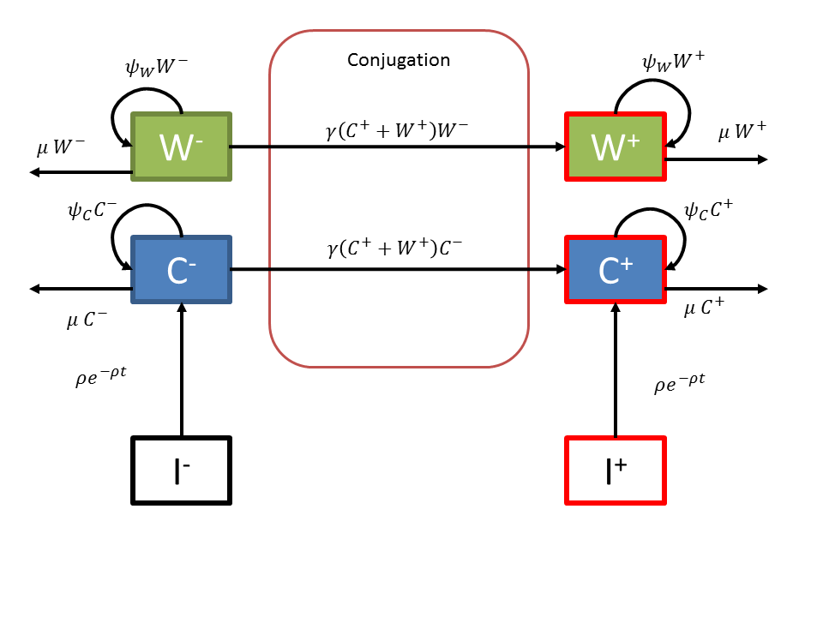

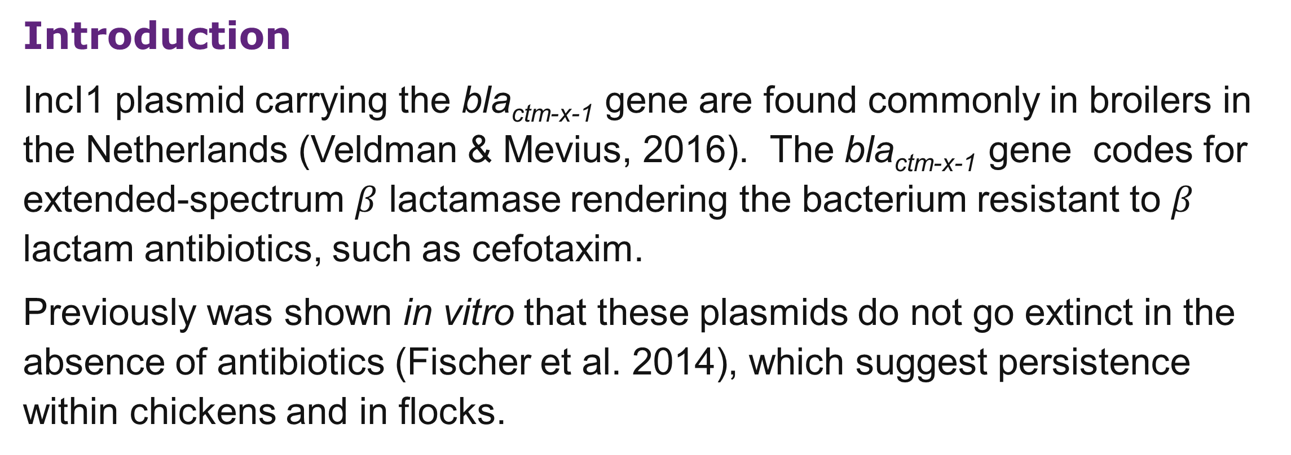
Unpredictable dynamics of ESBL producing E. coli within chicken guts
Deze ruimte kan gebruikt worden om extra logo’s te plaatsen of afzenders toe te voegen. Bijvoorbeeld faculteitsnaam, vakgroep, onderzoeksschool etc.
Let op dat er bij het correct gebruik van de UU huisstijl rondom het UU logo altijd een witruimte van minimaal 5 cm moet zijn!
Let op: in deze poster is de hoogte van deze paarse titelbalk aan te passen
Egil A.J. Fischer¹ | Cindy M. Dierikx² | Alieda van Essen-Zandbergen³ | Francisca C. Velkers¹ | Arjan Stegeman¹|
Dik Mevius^{1,3}| Don Klinkenberg²
1 Universiteit Utrecht, Faculty of Veterinary Medicine
2 RIVM, National Institute for Public Health and the Environment
3 Wageningen Bioveterinary Research
Introduction
IncI1 plasmid carrying the bla_{ctm-x-1} gene are found commonly in broilers in the Netherlands (Veldman & Mevius, 2016). The bla_{ctm-x-1} gene codes for extended-spectrum $β$ lactamase rendering the bacterium resistant to $β$ lactam antibiotics, such as cefotaxim.
Previously was shown in vitro that these plasmids do not go extinct in the absence of antibiotics (Fischer et al. 2014), which suggest persistence within chickens and in flocks.
Objectives
to find out
if ESBL carrying E. coli could colonize the gut of young chicks
and
if competition with the same strain without the plasmid in the inoculum influences the capability of colonization
Het gebruik van lijnen kan een duidelijke indeling van je poster versterken
Study design
Forty day-old chicks were randomly assigned to eight groups housed in a separate isolator without bedding material.
Orally inoculated by a syringe without needle with 0.5ml solution of 10⁶ CFU/ml E. coli at day 4 of age
Percentage ESBL in inoculum: 0%, 0.1%, 10%,100%
Faecal samples were taken by cloacal swaps on day 1, 2,6,9,13,16,20,23,27,30,34 and 37 post challenge.
Bacterial populations were counted using running drop method on selective plates.
Analysis
Trend analysis using Generalized Linear Models with group specific coefficients
Fit of the dynamic model using slightly informative priors
Stan and R-packages: rstan and rstanarm
Dynamics
Figure 2 Fractions of the total concentration of E. coli in the fecal samples of five chickens of wildtype E. coli without the plasmid (W⁻⁾, wildtype E. coli with the plasmid (W⁺), colonized E.coli without plasmid (C⁻) an colonized E. coli with plasmid (C⁺) for each of the isolators inferred by the dynamic model. A and B depict replicates of the same treatment (%-plasmid in the inoculum).
Dynamic Model
Figure 3 Estimated conjugation rates per isolator as indicated on the Y-axis. A and B depict replicates of the same treatment (%-plasmid in the inoculum). In vitro D and In vitro T are the estimates of the conjugation rate for the Donor and Transconjugant strain in Fischer et al. (2014).
Figure 1 Diagram of the model in which W are the wildtype E. coli and I the inoculum, which has not yet colonized. C depict the colonized inoculum and its descendants. Superscripts + and – depict populations with or without the IncI1 plasmid. The inoculum I will turn into colonizing bacteria C with a delay following an exponential-distribution with mean 1/ρ. The populations with plasmid will take part in conjugation with coefficient γ (conjugations per bacterium per hour). Bacterial populations grow with growth rate ψ and are flushed out with rate μ. Subscripts W or C define parameters for either the wildtype or colonizers.
Conclusions
100% ESBL carrying E. coli inocilate resulted in a larger fraction of the total E. coli population being the inoculum strain, than for no or partial ESBL carrying inoculate.
Inter- and intra-strain competition, differences in resident microbiota or a chance process potentially drive the success of colonization and persistence of ESBL carrying plasmids.
The conjugation coefficient was higher in these in vivo experiments than previous in vitro experiments indicating better conditions for conjugations in the chicken gut than in liquid LB medium between donor and recipient strains.
Trends
The model without “animal”have the lowest Watanabe Akaike Information Criterion. The intraclass correlation of grouping varaibel“animal” is lowest
 | C⁺ & C⁻ | C⁺ | C⁺ & W⁺
Animal | 0.015 | 0.001 | 0.006
Isolator | 0.118 | 0.094 | 0.258
Treatment | 0.181 | 0.722 | 0.462
Table 1. Intraclass correlations for the full model including variable Animal, Isolator, and Treatment as group specific variables and time as indepedent variable. C are the populations of colonized inoculum strains and W the wildtype strain. The superscripts ⁺ and – depict with or without the plasmid.
Contactgegevens
Afdeling Multimedia
Androclusgebouw, kamer w.146
Yalelaan 1 | 3584 CL Utrecht
T: 030-2533781
E: secretariaat.multimedia.vet@uu.nl
References
- Veldman & Mevius, 2016, MARAN, https://www.wur.nl/nl/Expertises-Dienstverlening/Onderzoeksinstituten/Bioveterinary-Research/Publicaties/MARAN-Rapporten.htm
- Fischer et al. 2014, BMC Microbiology, 14,77
Funding Population and Evolutionary Dynamics of ESBLs in Poultry (PEDEP) project sponsored by the Netherlands Organization for Health Research and Development

