Slide 1


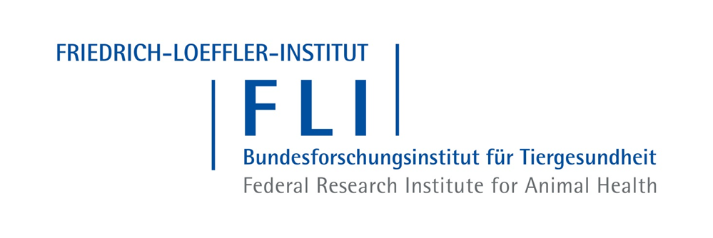
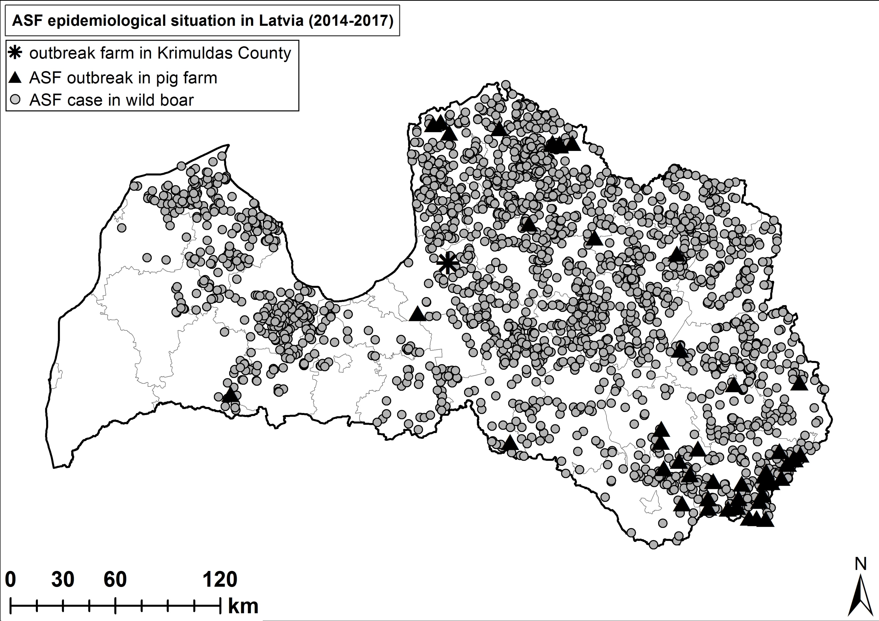
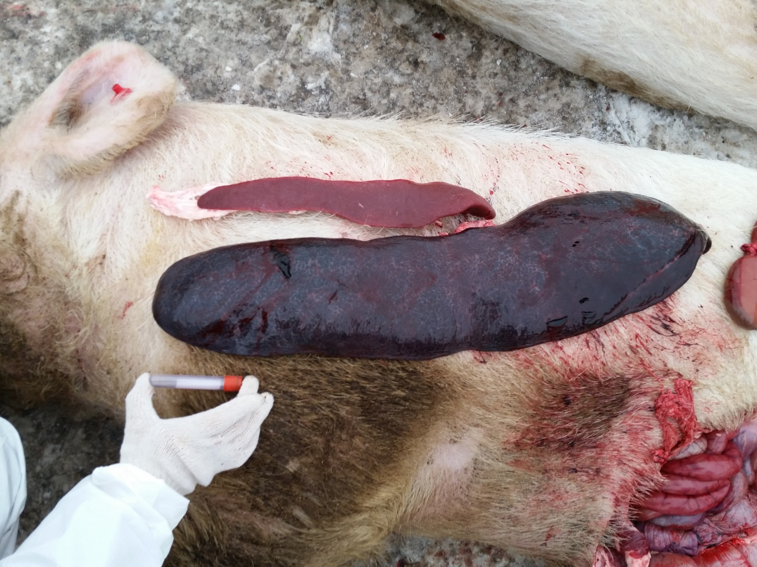
Epidemiological investigations in a large commercial pig farm affected by African swine fever
Kristīne Lamberga¹, Mārtiņš Seržants¹, Edvīns Oļševskis^{1,2}, Katja Schulz³, Klaus Depner³
1 Food and Veterinary Service, Riga, Peldu 30, LV-1050, Latvia
2 Institute of Food Safety, Animal Health and Environment - "BIOR", Riga, Lejupes 3, LV-1076
3 Friedrich-Loeffler-Institut, Suedufer 10, 17493, Greifswald-Insel Riems, Germany
ABSTRACT
RESULTS AND DISCUSSION
In Mid-January 2017 a large commercial pig breeding farm in Latvia with almost 5000 animals was affected by African swine fever (ASF). Epidemiological enquiries using a hypothesis based approach were conducted to trace the source of virus and to reconstruct the course of the disease until notification. Although the farm was located in an area where the disease is circulating in the wild boar population (Picture 1), it was found highly unlikely that wild boar might have played a direct or indirect role in this outbreak. Management inconsistencies related to human behavior proved to be the main vulnerabilities for virus introduction. Farm management did not fulfill biosecurity requirements in all aspects to prevent virus introduction. Therefore, the human factor could not be ruled out and has been considered to be the most serious risk factor. Most probably the ASF virus entered the farm beginning of December 2016, about six weeks before disease confirmation. It was concluded that early detection of ASF by passive surveillance is most crucial and has to be improved. In risk areas dead pigs should be compulsory tested for ASF even if farm mortality is below the normal threshold.
Possible length of time during which ASF virus may have existed on the farm: a time-line of the potential course of the disease was created based on laboratory results, anamnestic data, records on morbidity, mortality and post mortem findings. The initial virus spread within the farm was slow; only few animals were affected until beginning of January. Our findings do not support a massive virus introduction.
Biosecurity and risk pathways: daily management of the farm did not fulfill biosecurity requirements in all aspects. The weakest points were the sanitary filters for the staff. The farm employees could bring and consume their own food inside the farm. In addition a significant contribution to poor biosecurity may have been the large turnover of employees (~50%) 10 weeks prior to confirmation ASF.
Possible origin of ASF on the holding:
1) Wild boar hypothesis - although the farm was located in a restricted area due to ASF in wild boar, no direct or indirect contacts with wild boar were identified. The farm was fenced and effectively prevented from the access of wild boar. No wild boar traces have been seen in the vicinity. No indirect contacts to the wild boar environment were identified. No farm employees participated in hunting or were involved in activities linked to wild boar. Based on these findings it is highly unlikely that wild boar might have played a role in this outbreak.
2) Fomites and meat hypothesis - due to the insufficient biosecurity, infectious material could have entered the farm and ASFV introduction by people could not be ruled out.
3) Trade hypothesis – the farm did not receive any live pigs during previous 12 months, therefore, virus introduction via infected pigs could be excluded.
Enlarged spleen of ASF infected breeding boar
Picture 1
OBJECTIVES
The objective of the study is to detect the possible time and source of ASF virus introduction into the farm.
MATERIALS AND METHODS
Picture by Food and Veterinary Service, Latvia
The study included several farm visits comprising interviews with the farm manager, veterinarian and farm workers. Additional information was obtained from the local veterinary service and the rendering company servicing the farm. Basically two different aspects were addressed: the biosecurity of the farm setup (buildings, fences, equipment, vehicles, etc.) and the biosecurity linked to management procedures (hygiene protocols, internal work flow, movements of people and vehicles, etc.).
To structure the investigations concerning the origin of the ASFV a hypothesis based approach was chosen. Each hypothesis was addressed separately to prove or reject it. Three working hypotheses were formulated:
wild boar hypothesis: direct or indirect contacts with infected wild boar
meat hypothesis: contact with contaminated meat or meat products or fomites
trade hypothesis: introduction of infected pigs
The hypotheses were based on possible virus transmission routes, e.g. ingestion of infected meat or meat products, contact between sick and healthy animals and fomites.
Picture 2
CONCLUSIONS
The hypothesis based working approach proved to be a suitable tool to conduct epidemiological enquiries, particularly to exclude some potential ways of virus introduction. However, certain risk factors remained unclear, particularly some aspects related to human activities on the farm.
The human factor proved to be the main risk for ASFV introduction. Farm biosecurity has to be addressed more rigorously, particularly all aspects related to human activities.
Early detection of disease is essential. Passive surveillance must be enhanced in ASF restricted and risk areas. In breeding farms all dead gilts, sows and boars must be compulsory tested for ASF, even if farm mortality is below the normal threshold. In fattening farms at least the first two deaths in each production unit each week, should be tested for ASF virus.

