Slide 1
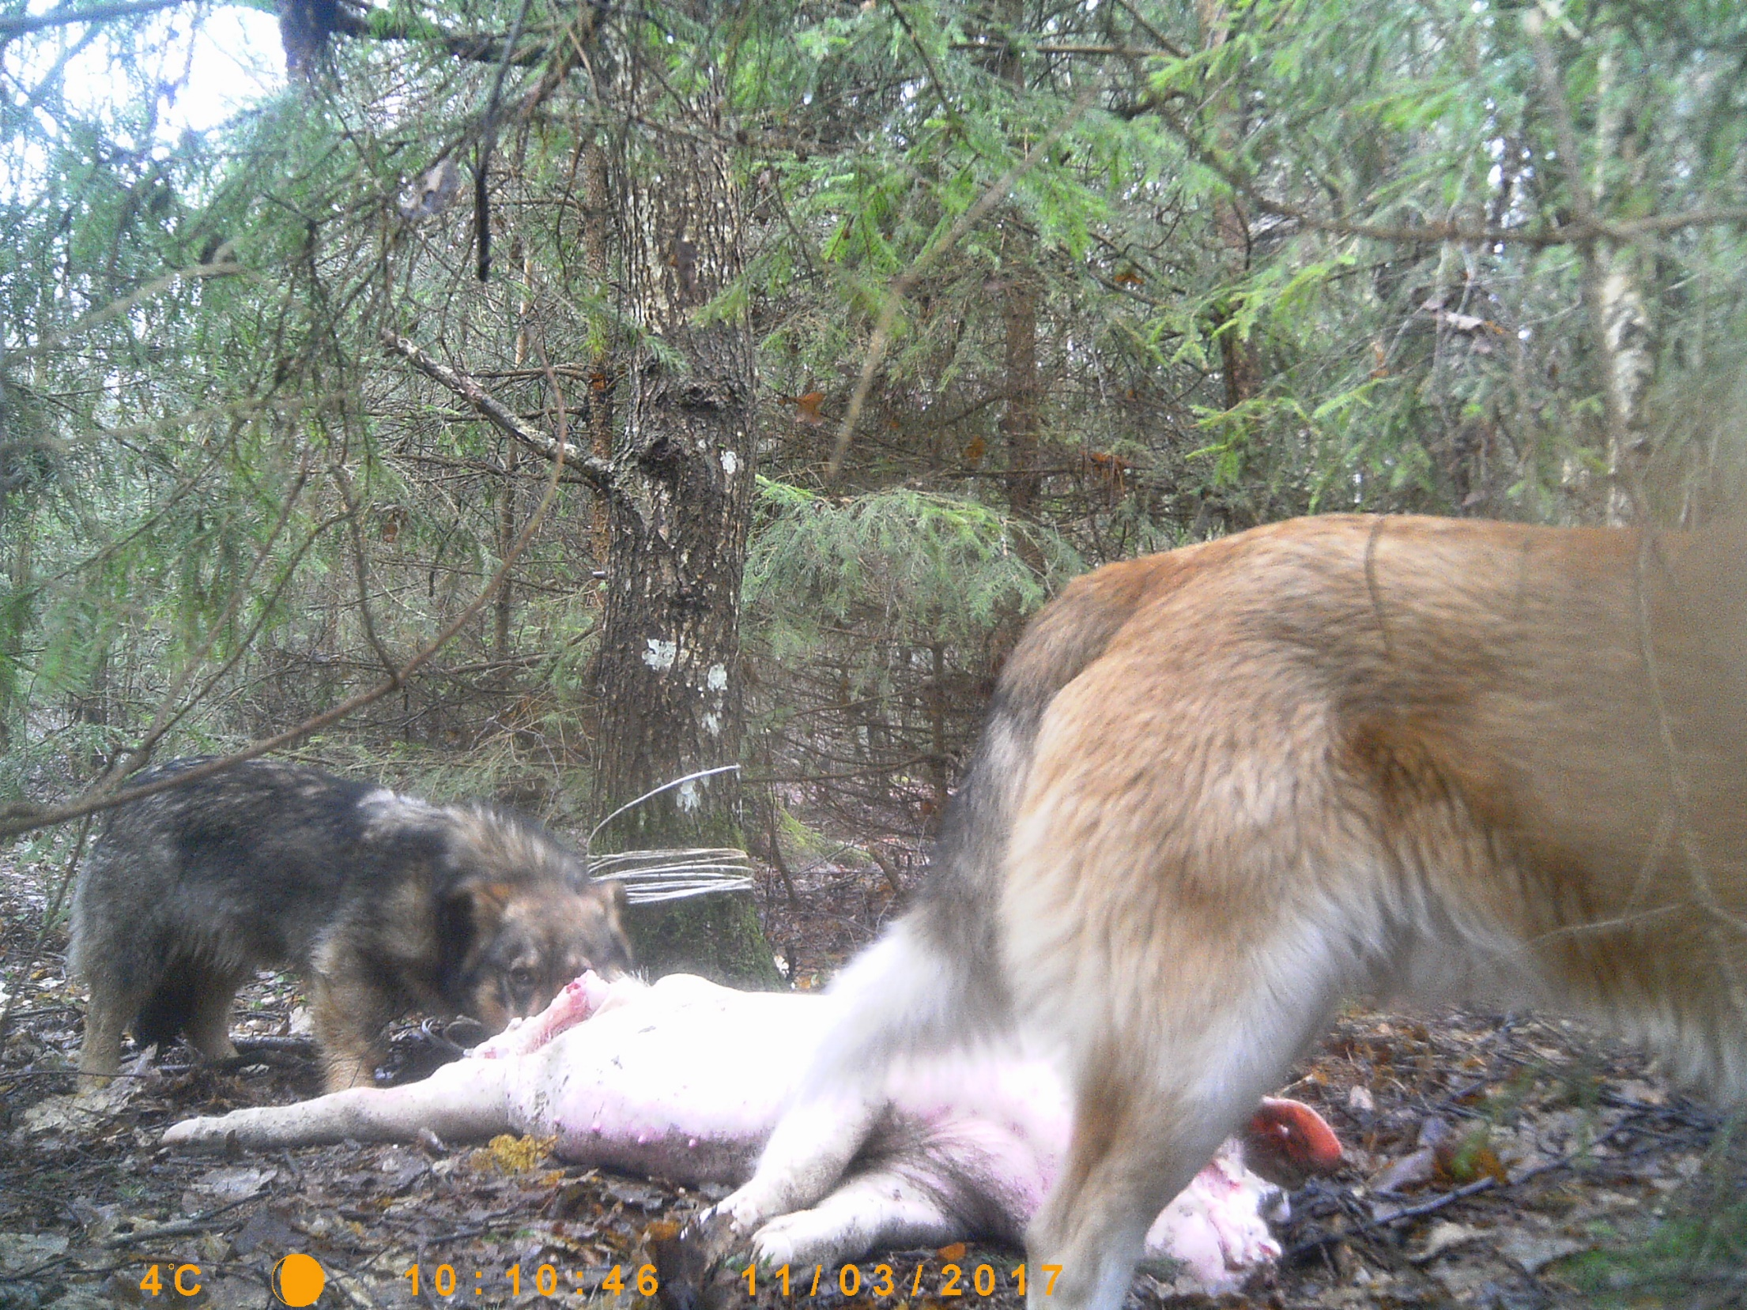
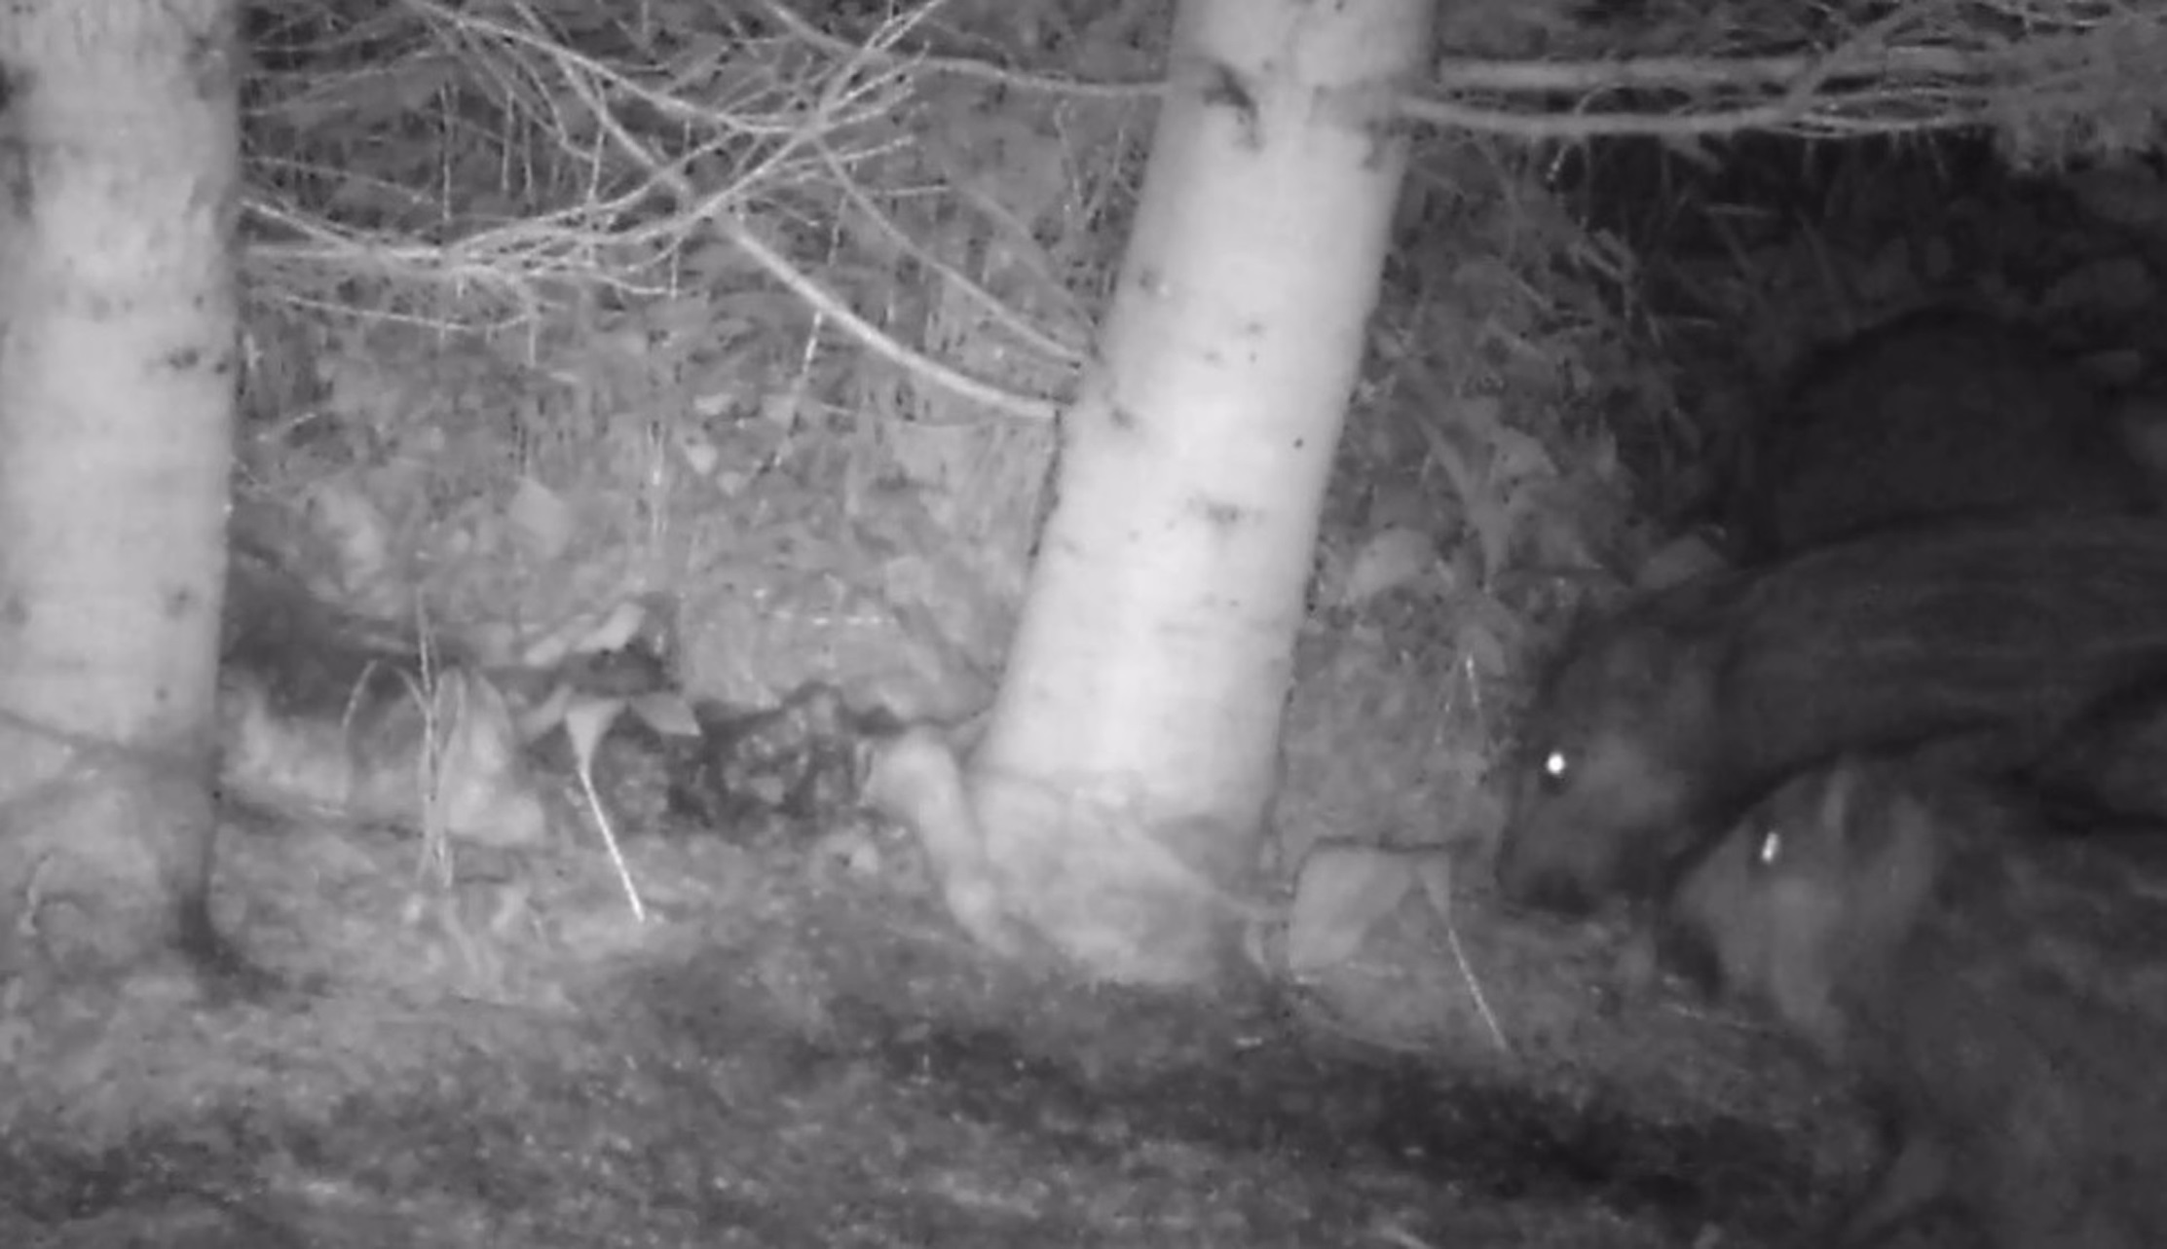


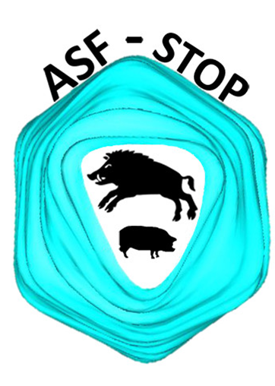

SVEPM
Marius Masiulis^{1,2}, Paulius Bušauskas², Vaidas Jonušaitis², Gediminas Pridotkas³, Anja Globig⁴, Katja Schulz⁴, Klaus Depner⁴
21-23 MARCH 2018, TallinN, ESTONIA
¹ 1Lithuanian University of Health Sciences, Veterinary Academy, Kaunas, Lithuania
² State Food and Veterinary Service of the Republic of Lithuania, Vilnius, Lithuania
³ National Food and Veterinary Risk Assessment Institute, Vilnius, Lithuania
⁴ Friedrich-Loeffler-Institute, Greifswald-Insel Riems, Germany
Domestic pig carcasses disposed in the forest –
do they play a role in the transmission of
African swine fever?
African swine fever virus (ASFV) can persist over weeks or months at low environmental temperature. The virus also survives the process of putrefaction and contaminated carcasses may remain infectious in fields or forests for weeks. Depending on the frequency at which naive animals have contact with infected carcasses, the spread of ASFV through carcasses is considered to be more important than direct contact with live infectious animals. Aiming to answer the questions whether pig carcasses, infected with ASFV might be a source of infection for wild boar, three domestic pig carcasses have been disposed in the forest and monitored by wildlife cameras.
Days with soil contact (rooting)
Days with carcass contact
Presence of pig carcasses
On seven out of 956 pictures and on five out of 499 videos at least one wild boar was recorded close to the carcass (<2 meters). Groups of wild boar (adult and piglets) have been recorded only on S3. No visits with wild boar close to the carcasses were recorded during day time. The animals approached the site solitary (adult or young pigs), as part of small groups, or as part of large groups with up to 30 animals (mainly sows with piglets). The minimum distance kept to the carcass ranged between 30 cm and 2 m. The average time a group or a solitary animal spent at the site during a visit ranged from 0.5 to 5 minutes.
Study
side 2 (S2)
Study
side 3 (S3)
11/16
12/16
1/17
2/17
3/17
4/17
5/17
6/17
Timeline (month/year)
Direct contacts were recorded only on S3; during one night on day 38 six piglets (< 2 month old) sniffed and poked on the pig carcass without leaving any signs of cannibalism. Adult wild boar had no direct carcass contact; they were only observing the piglets.
Our findings are very similar with those described by Probst et al. (2017)* concerning the behavior of wild boar towards carcasses of their own conspecifics. Wild boar behavior towards pig carcasses and wild boar carcasses is similar. The contacts are rather seldom but potentially sufficient to transmit ASF. Obviously, we cannot determine whether the observed contacts would have been intensive enough to transmit ASF. Probably several contacts are needed until infection takes place. We also assume that if one animal acquires infection, the other members of the social group would subsequently become infected. Taking into account the long time during which ASFV may remain infectious in a protein-rich environment, sporadic late contacts may be as important as contacts with fresh carcasses with respect to the risk of ASF transmission.
Dogs consuming pig carcass
Piglets sniffed and poked on the pig carcass
* Probst C, Globig A, Knoll B, Conraths FJ, Depner K (2017) Behaviour of free ranging wild boar towards their dead fellows: potential implications for the transmission of African swine fever. Royal Soc Open Sci 4

